Slide 1

LGSI Project
Smart Cart
- with Indoor Navigation -
TEAM 12
MINJUN KIM
JIHUN CHOI
JIHYE CHOE
GANGHYEOK LEE
YUJIN KWAK
LG Soft India, 15.07.2019
Notes:
http://minheeblog.tistory.com/category/PPT
빈버드 그림 배경 좀 지웠습니다.
12 팀인거랑 발표 장소 날짜 추가했습니다.
With이 indoor navigation이랑 붙는게 의미상 맞을거 같은데 디자인은 with이 올라가는게 나을거 같기도 하고 잘 모르겠어요 그래서 smart cart를 강조하고 indoor navigation을 줄여보았습니다.

Slide 2
CONTENTS
01 Introduction
02 Development & Architecture
03 Research
04 Demo
Notes:
http://minheeblog.tistory.com/category/PPT

Slide 3
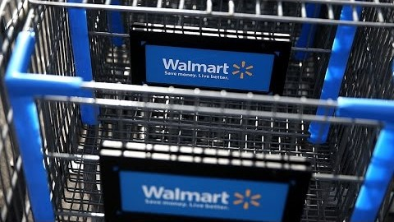
INTRODUCTION
01
Why we need Smart Cart?
3
Notes:
https://www.youtube.com/watch?v=csxLiqvaxJ0

Slide 4
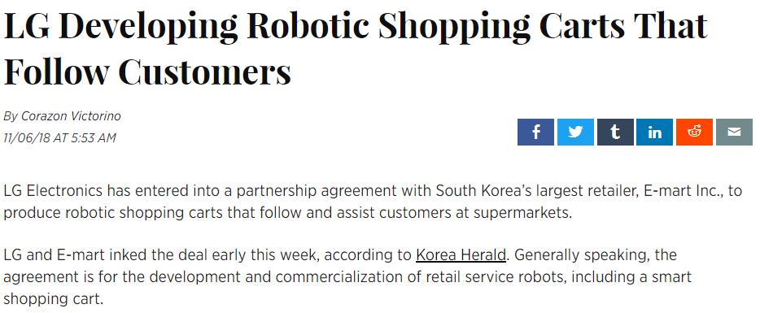
INTRODUCTION
01
Functionality of Smart Cart
Smart Cart “Eli” developed by LG Electronics
4
Notes:
http://minheeblog.tistory.com/category/PPT

Slide 5
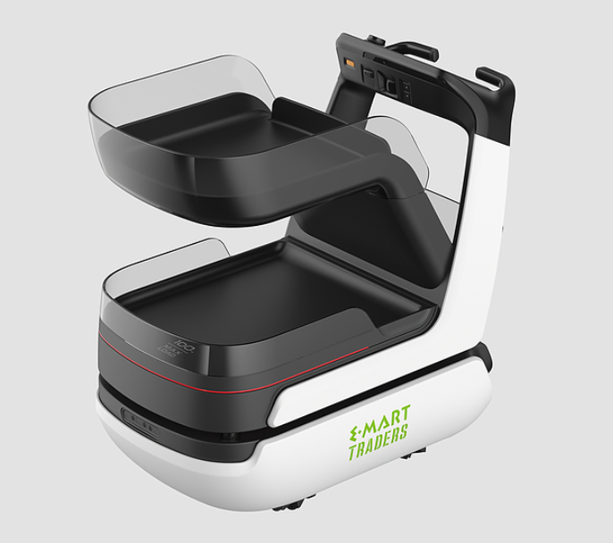
INTRODUCTION
01
Functionalities of the Smart Cart “Eli”
(Advantages of a Smart Cart)
What do you think the functionalities of “Eli” might be?
Indoor positioning/navigating system
Searching products
Sensors for human recognition
Speech recognition
Instant payment feature
Etc …
5
Notes:
http://minheeblog.tistory.com/category/PPT
Eli를 강조해보았습니다.
애니메이션 효과 바꿨습니다.

Slide 6
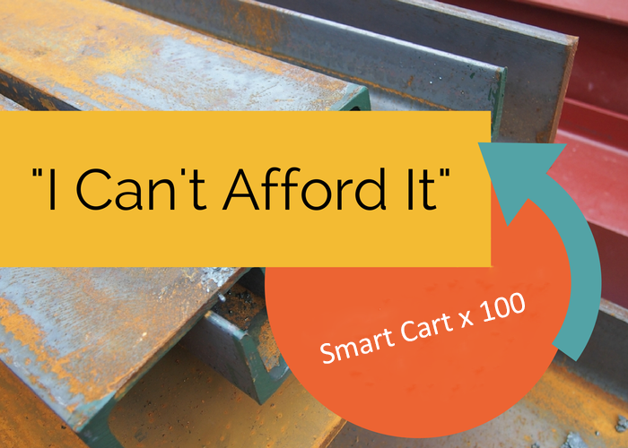
INTRODUCTION
01
Disadvantages of Smart Cart
If you were a mart manager, would this be a feasible investment?
Shopping cart prices
: ₹ 5,500 ~ ₹ 8,500
: (KRW 100,000 ~ 150,000)
<
x 2.5 ↑
Smart Cart Prices
(cart + screen + tech)
: ₹ 15,000 ~ ₹ 23,000
: (KRW 250,000 ~ 400,000)
6
Notes:
http://minheeblog.tistory.com/category/PPT
부등호 진짜 부등호로 바꿨어요

Slide 7
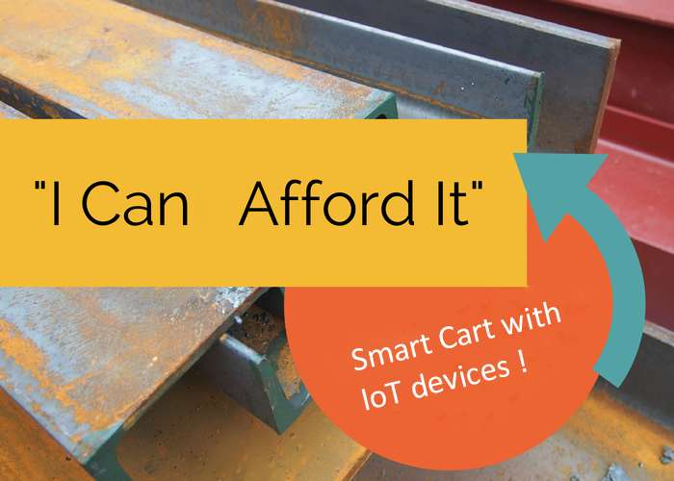
INTRODUCTION
01
Disadvantages of Smart Cart
Therefore, we designed the smart cart with minimal IoT technologies/devices to make it more affordable.
Raspberry Pi + Beacon
+ cart + screen
– tech price
We can reduce production costs by using cheaper IoT device alternatives
7
Notes:
http://minheeblog.tistory.com/category/PPT
사진 위치 바꿨습니다.
.6
첫번째 We=> we
두 번째 we => We
수식 위치를 바꾸어 보았습니다.

Slide 8
DEVELOPMENT
02
Requirements
The cart should be able to display its position indoors.
The cart should be able to display the selected items and the optimal path to them.
The cart should be RFID-aware and able to receive pricing information of the item.
8
Notes:
http://minheeblog.tistory.com/category/PPT
글머리 서식 다 추가했습니다.
한글은 16pt로 줄였습니다.
ㅂ니다 체로 바꿨습니다

Slide 9
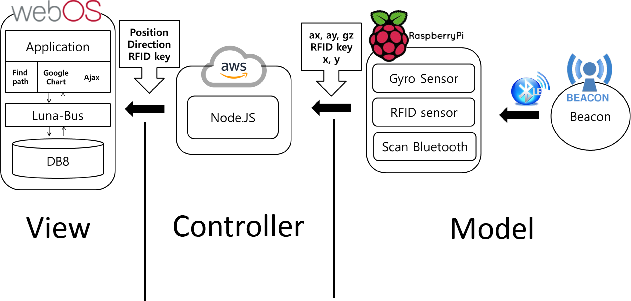
DEVELOPMENT
02
System Architecture
(MVC Pattern)
9
Notes:
http://minheeblog.tistory.com/category/PPT

Slide 10



DEVELOPMENT
02
Scenario
(Indoor Navigation)
As the cart moves, it stores the gyro sensor value and the distance to the beacon.
The cart passes the values to the server.
The server converts the received values to x, y, θ coordinates.
ax, ay, gz
RFID key
x, y
Node.JS
10
Notes:
http://minheeblog.tistory.com/category/PPT
한글 14pt로 줄이고 모두 글머리 서식 씌웠습니다.
도형 위치 조금 옮겼습니다.
Process부분이랑 처리한다 부분 빼고 바로 변환합니다로 바꿨습니다.
원래 그림이 약간 짜부된거 같아서 보기 좀 그래서 도형 배치 좀 바꿨는데 더러워 보이면 원래대로 하셔도 괜찮을듯 해요.

Slide 11
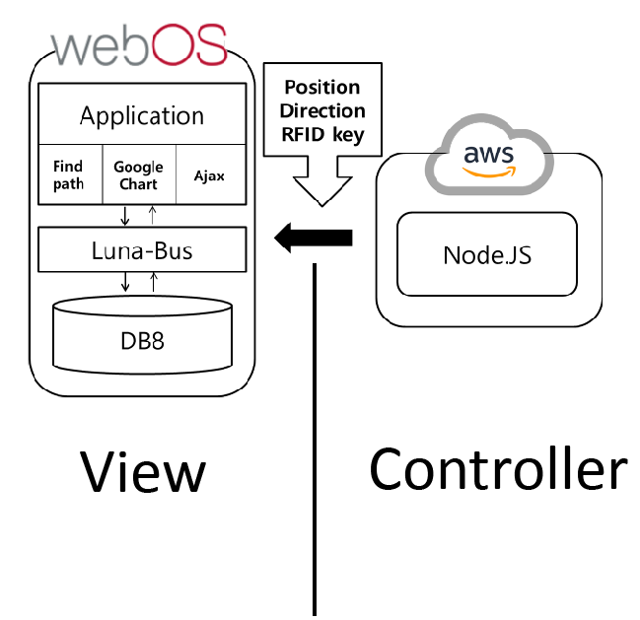
DEVELOPMENT
02
Scenario
(Indoor Navigation)
The server saves the converted x, y, θ coordinates, and the webOS application performs ajax communication to get the coordinate values.
The webOS application takes these values(JSON format) and prints them to View.
11
Notes:
http://minheeblog.tistory.com/category/PPT
한글 14pt로 줄이고 모두 글머리 서식 씌웠습니다.
도형 위치 조금 옮겼습니다.
4. x, y and θ => coordinate(x, y and θ => 좌표 값)
5. This => these
.6
4 - 앞 슬라이드에서 x, y, theta로 표현했어서 and 뺐어요

Slide 12
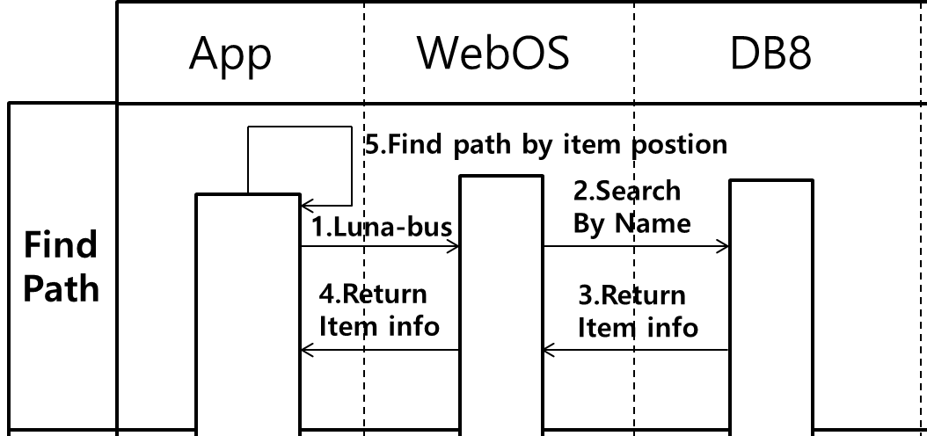
DEVELOPMENT
02
Scenario
(Optimal Path)
In the application, put items that you want to buy into the shopping cart, and click the “DIRECTIONS” button.
The application retrieves the name of the items from DB8 through the find method.
12
Notes:
http://minheeblog.tistory.com/category/PPT
한글 16pt로 줄이고 모두 글머리 서식 씌웠습니다.
도형 위치 조금 옮겼습니다.
ㅂ니다체로 바꿨습니다.

Slide 13
DEVELOPMENT
02
Scenario
(Optimal Path)
Once the webOS service has received the items’ information, it delivers the information to the application.
The application finds the x, y coordinates of the best path to the items using the optimal path algorithm and displays them in the UI.
13
Notes:
http://minheeblog.tistory.com/category/PPT
한글 16pt로 줄이고 모두 글머리 서식 씌웠습니다.
도형 위치 조금 옮겼습니다.
ㅂ니다체로 바꿨습니다.

Slide 14
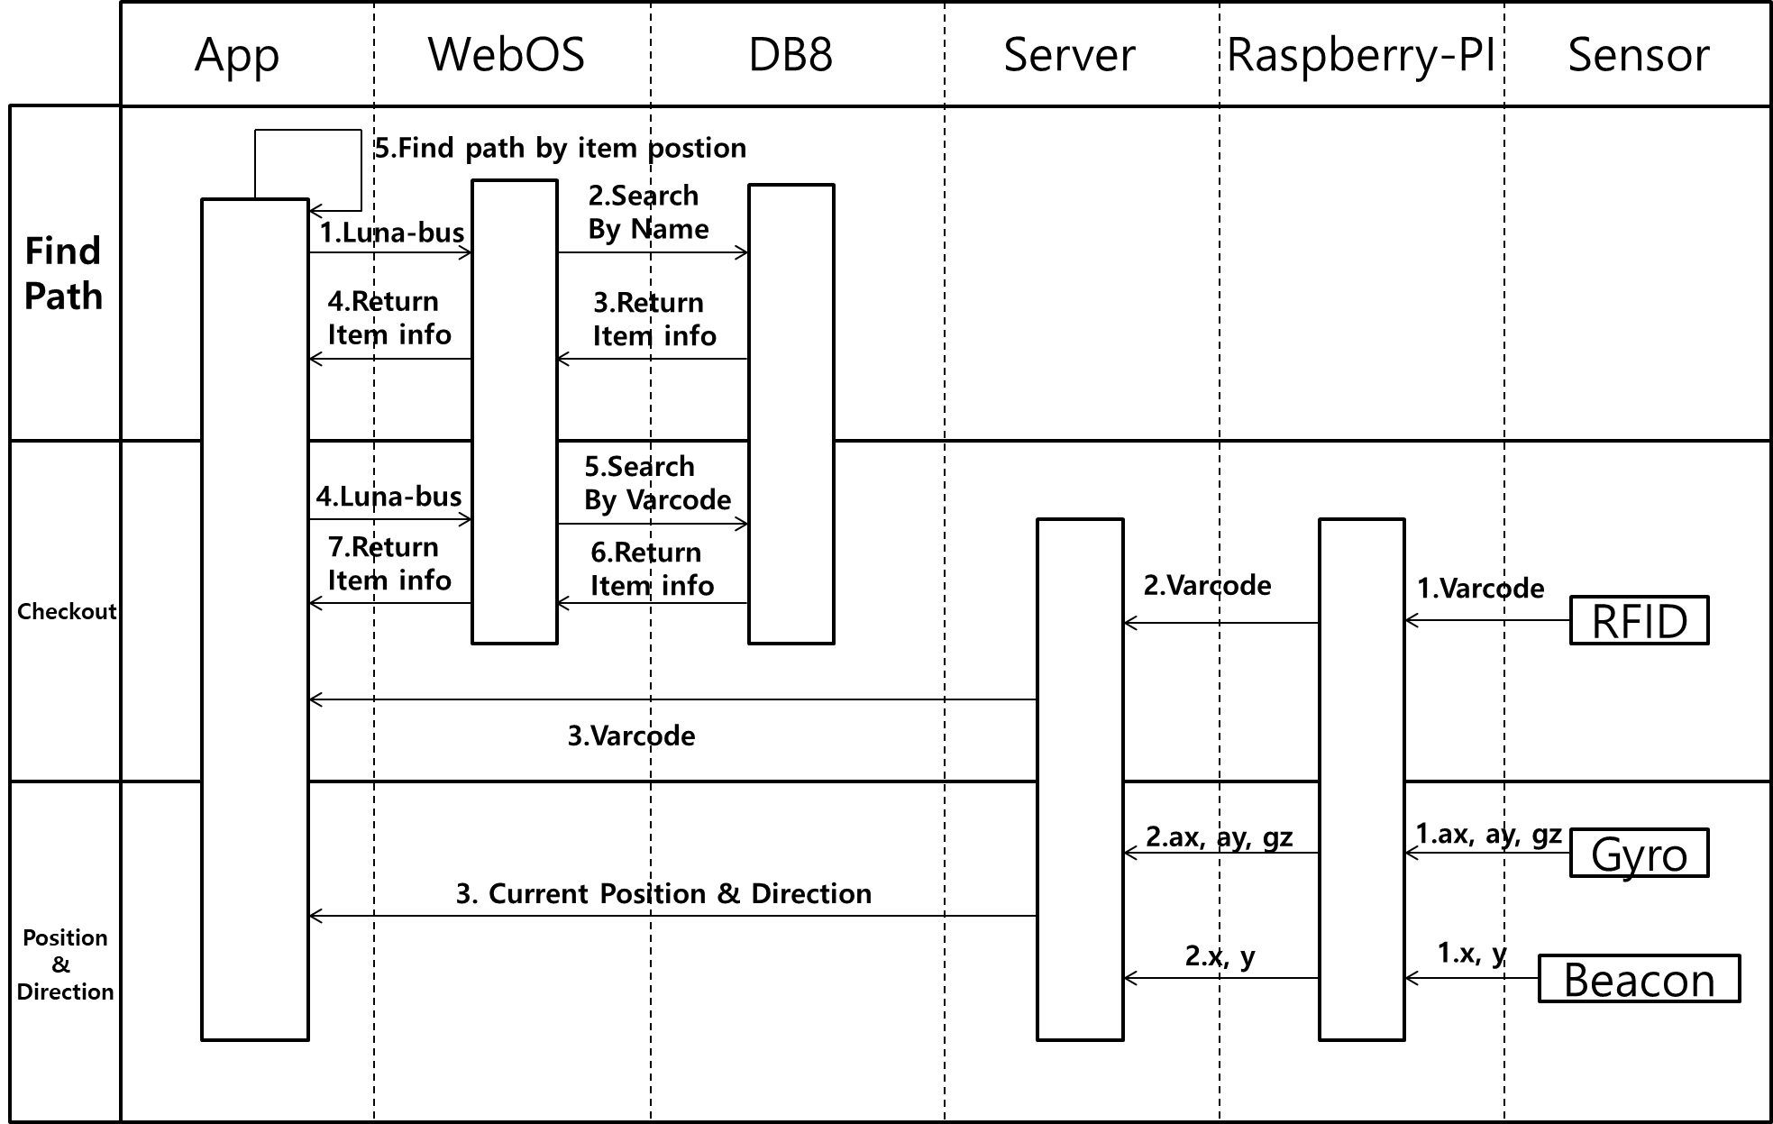
ARCHITECTURE
02
Sequential Diagram
(Overview)
14
Notes:
http://minheeblog.tistory.com/category/PPT
Sequential Diagram (Overview)

Slide 15
ARCHITECTURE
02
Gantt Chart
(ISSUE)
Requirement | D-9 | D-8 | D-7 | D-6 | D-5 | D-4 | D-3 | D-2 | D-1
----- Raspberry Pi ----- (Front 1, Model)
Extracting sensor values (9-axis sensor, RFID, Beacon)
Connection between RaspberryPi and Node Server.
----- Node.js ----- ( Back-end, Controller)
Research and Application of Dead Reckoning Algorithm
Connection between Node and webOS through AJAX communication.
----- webOS ----- (Front 2, View)
Connection between webOS and DB8, developed the DB Schema.
Developing optimal path algorithm and application.
Searching for library to show real-time coordinates.
Developing the UI.
----- Project Manage ------
Preparation of Final experiments and Presentations.
15
Notes:
http://minheeblog.tistory.com/category/PPT
D-#이면 숫자 카운트 다운 해야하는거 아닌가요???

Slide 16
RESEARCH
03
Distance calculation
How to compute distance through sensor values?
Why Indoor Navigation is not accurate?
Calculation through beacon sensor values (TX Power, RSSI)
Calculation through accel, gyro sensor values and apply Dead Reckoning Algorithm
Etc …
16
Notes:
http://minheeblog.tistory.com/category/PPT

Slide 17
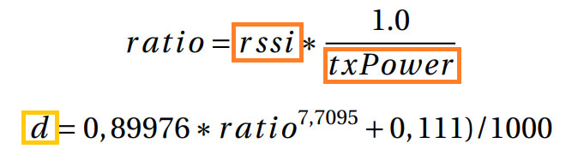
RESEARCH
03
Beacon Sensor values
TX Power : Broadcasting Power and Beacon’s Range (unit : dBm)
(ex : 1mW = 0dBm , 10mW = 10dBm, 100mW = 20dBm)
RSSI : Received Signal Strength Indicator (unit : dBm)
Drawback : these may be disturbed by other waves. Inaccurate !
17
Notes:
http://minheeblog.tistory.com/category/PPT

Slide 18
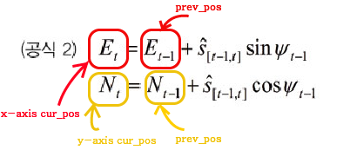
RESEARCH
03
What is Dead Reckoning?
Dead Reckoning is the process of calculating one’s current position by using a previously determined position.
Drawback : Error accumulates over time by recursive process !
18
Notes:
http://minheeblog.tistory.com/category/PPT
18슬라이드랑 19슬라이드랑 같길래 19 지웠어요

Slide 19
RESEARCH
03
Calibrate ?
Case 1. Error rate when we measuring beacon sensor distance.
Case 2. Error rate between the result distance and the actual distance
when dead reckoning is performed.
Case 3. Error rate when combining case 1 and case 2.
 | Beacon dist | D.R dist | sub | Error rate
1 | To be continue...
2
3
4
5
6
7
8
9
10
Sum
19
Notes:
http://minheeblog.tistory.com/category/PPT

Slide 20
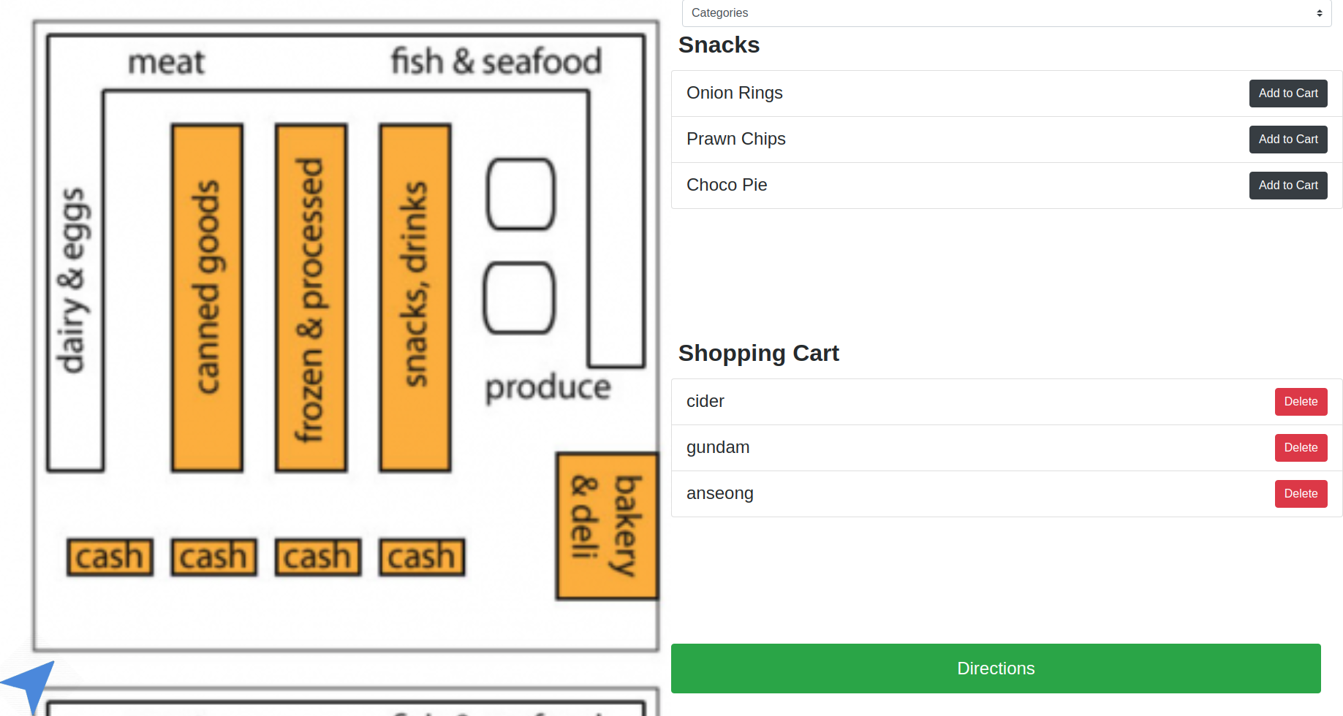
DEMONSTRATION
04
Demo
20
Notes:
http://minheeblog.tistory.com/category/PPT

Slide 21
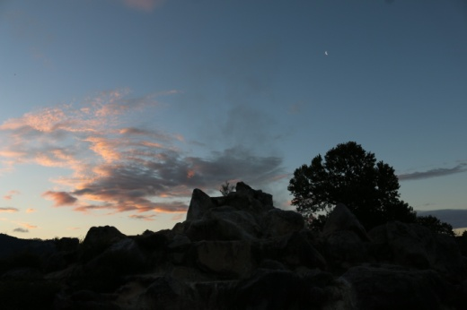
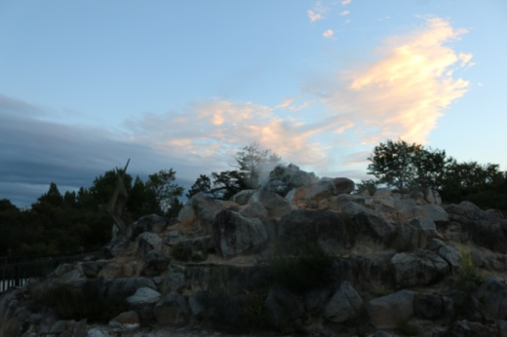
LGSI PROJECT
04
“ ”
LGSI TEAM-12
MINJUN KIM :
JIHUN CHOI :
JIHYE CHOE :
GANGHYEOK LEE :
YUJIN KWAK :
21
Notes:
http://minheeblog.tistory.com/category/PPT

Slide 22
LGSI PROJECT
Q & A
Notes:
http://minheeblog.tistory.com/category/PPT

Slide 23
LGSI PROJECT
THANK
YOU
Notes:
http://minheeblog.tistory.com/category/PPT
오타인척 Think Q는 어떨까요

